Slide 1

Rainfall Prediction Model
This presentation explores the development of a machine learning model for accurate rainfall prediction.
Konal Puri: 500106904
Gaurav Chhajer: 500107437

Slide 2
Introduction
Purpose
Beneficiaries
Our objective is to create a model that accurately forecasts rainfall using historical weather data.
Farmers can optimize irrigation, meteorologists enhance forecasting, transport authorities mitigate disruptions, and the general public can plan accordingly.

Slide 3

Project Scope
1
Supervised Learning
2
Workflow
3
Dependencies
We'll utilize supervised learning models such as Logistic Regression, Random Forest, and XGBoost.
Our project involves data collection, preprocessing, model training, evaluation, and deployment.
We will utilize libraries like sklearn, pandas, and xgboost, and leverage cloud services like AWS EC2.

Slide 4
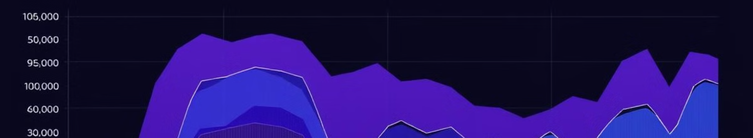
Algorithms & Data
Algorithms
Key Features
Target Variable
We will explore various machine learning algorithms, including Logistic Regression, Random Forest, Gradient Boosting, SVM, and XGBoost.
Our model utilizes key features such as minimum temperature, maximum temperature, rainfall, humidity, wind speed, and pressure.
The target variable is "RainTomorrow\_encoded," indicating whether rain is expected the following day.

Slide 5
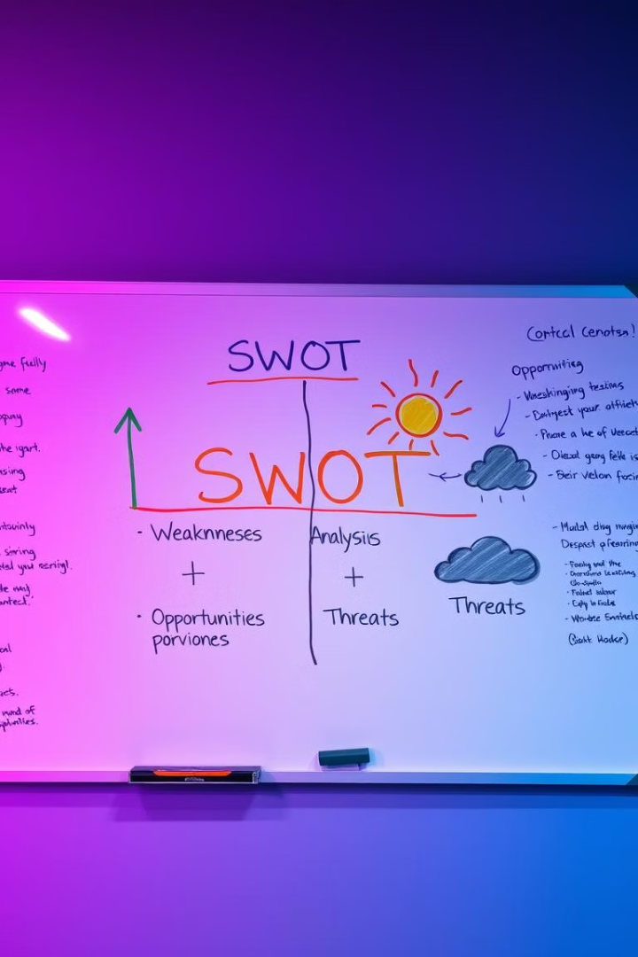




SWOT Analysis
Strengths
Weaknesses
We have access to a robust dataset and the potential to impact various sectors.
Data quality can significantly impact model accuracy.
Opportunities
Threats
Integration with IoT and real-time monitoring can enhance prediction accuracy.
Changes in weather patterns and data privacy concerns pose challenges.

Slide 6

Project Features
1
Preprocessing
We will perform data cleaning and encoding to prepare the data for model training.
2
Evaluation
Model evaluation will be conducted using metrics like accuracy, precision, recall, F1-score, and ROC-AUC.
3
Persistence
Trained models will be saved using joblib for future use and deployment.

Slide 7



User Roles & Constraints
Users
Our system will cater to developers, data scientists, farmers, meteorologists, and administrators.
Constraints
Hardware limitations, software compatibility issues, and data challenges require careful consideration.

Slide 8



Design Diagrams
Data Flow
1
Visual representation of data flow through the system.
UML Classes
2
Detailed representation of system components.
Architecture
3
Overview of the system's infrastructure and connections.

Slide 9
System Requirements
User Interface
1
A simple web form for user interaction.
Software
2
Utilizing AWS EC2, Flask API, and GitHub for development and deployment.
Database
3
MySQL/SQLite for data storage and S3 for data management.
Protocols
4
HTTP/HTTPS and REST API for communication and data exchange.

Slide 10

Thank You

